Slide 1

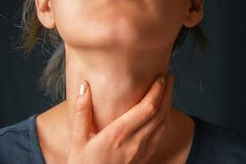
DETECTION OF THYROID DISORDERS USING MACHINE LEARNING APPOARCH
PRESENTED BY :
21RH1A05H5
21RH1A05J2
21RH1A05D1
21RH1A05H3

Slide 2

Contents :
Abstract
Introduction
Methodology
Dataset’s
Architecture
Algorithms
Results
Conclusion
Reference

Slide 3
ABSTRACT :
Classification based Machine learning plays a major role in various medical services. In medical field, the salient and demanding task is to diagnose patient’s health conditions and to provide proper care and treatment of the disease at the initial stage. Let us consider Thyroid disease as the example. The normal and traditional methods of thyroid diagnosis involve a thorough inspection and also various blood tests. The main goal is to recognize the disease at the early stages with a very high correctness. Machine learning techniques play a major role in medical field for making a correct decision, proper disease diagnosis and also saves cost and time of the patient. The purpose of this study is prediction of thyroid disease using classification Predictive Modelling followed by binary classification using Decision Tree ID3 and Naive Bayes Algorithms. The Thyroid Patient dataset with proper attributes are fetched and using the Decision Tree algorithm the presence of thyroid in the patient is tested. Further, if thyroid is present then Naïve Bayes algorithm is applied to check for the thyroid stage in the patient.

Slide 4
INTRODUCTION :
Thyroid disease diagnosis is not a simple task. It involves many procedures. The normal traditional way includes a proper medical examination and many blood samples for blood tests. Therefore, there is a necessity for a model which detects the thyroid disease at a very early stage of development.
In medical field machine learning plays an important role for thyroid disease diagnosis as it has various classification models based on which we can train our model with proper train dataset of the thyroid patient and can predict and give the results in an accurate manner with higher degree of correctness.
Some recent studies from Mumbai have suggested that congenital hypothyroidism is common in India. The disease occurs in 1 part of 2640 new born children, when compared to the worldwide average range of 1 in 3800 considered. Congenital hypothyroidism can lead to serious complications if not detected in early stages. Therefore, the proposed model serves the goal in early detection of thyroid disease.
Based on the obtained test values the health care staff can easily examine the condition of the patient and also skip further clinical examinations if not necessary. Hence, this approach proves to be very much beneficial to the healthcare field. A proper train dataset results into an accurate predicting model therefore reducing the overall cost of the thyroid patient treatment and also saving the time . Classification algorithms are most suitable in decision making and also solving the real-world problems

Slide 5
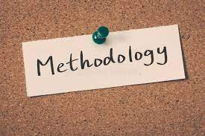
METHODOLOGY :
For this research, I've chosen to use a variety of supervised learning classification algorithms.
The efficient algorithms for differentiation regression analysis that are currently in use.

Slide 6
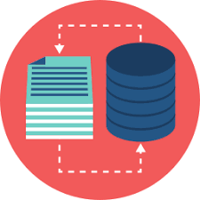
DATASET’S:
It contain two data sets.
Hypothyroid:
Hypothyroid data set contains more that 3500 records.
2. Test data:
Contains the data for testing

Slide 7
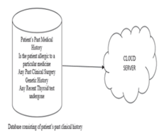
ARCHITECTURE :

Slide 8
ALGORITHMS :
Navie Bayas (NB)
Support vector machine (SVM)
Random forest (RF)

Slide 9
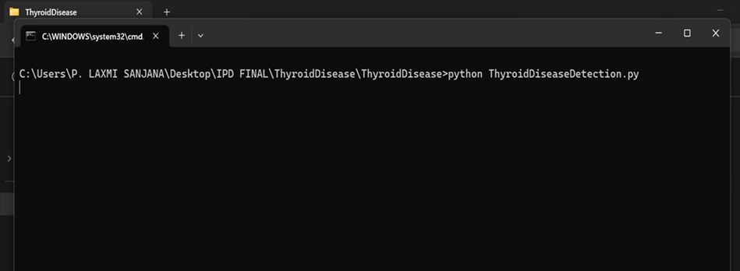
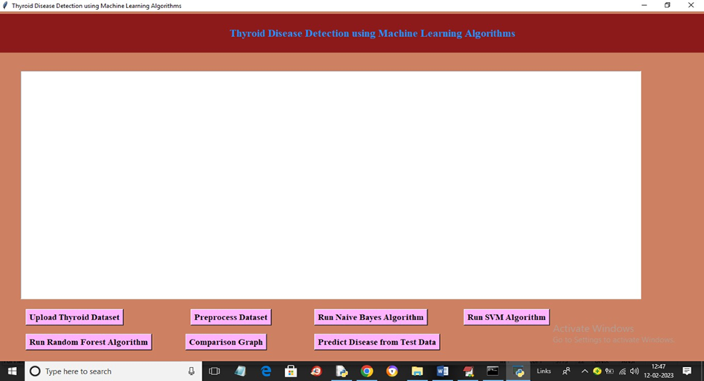
RESULTS :

Slide 10
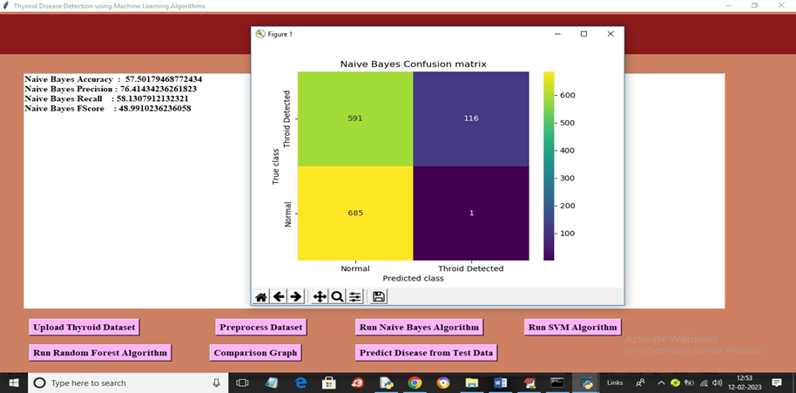
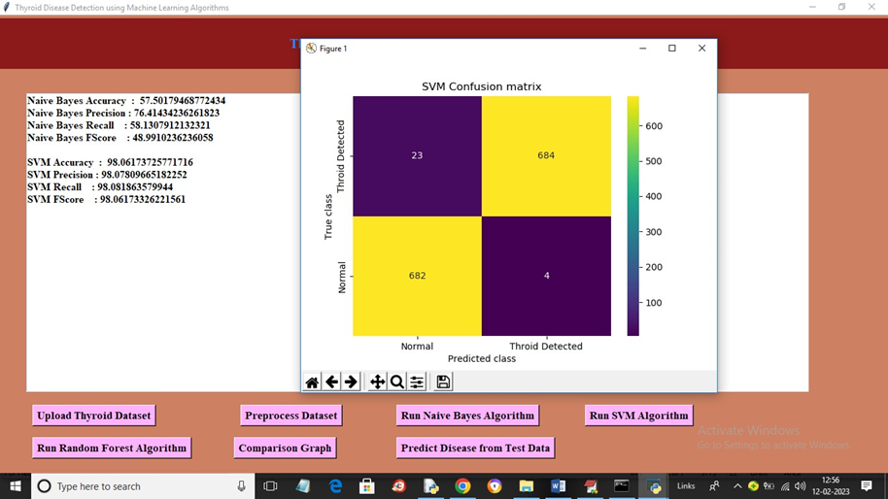

Slide 11
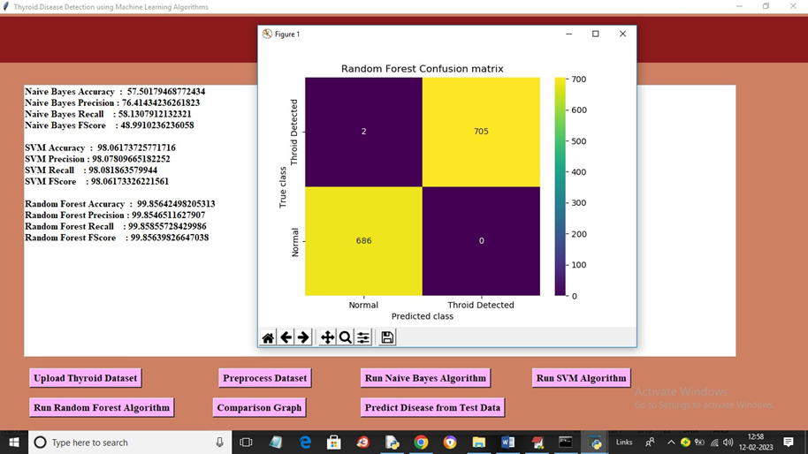
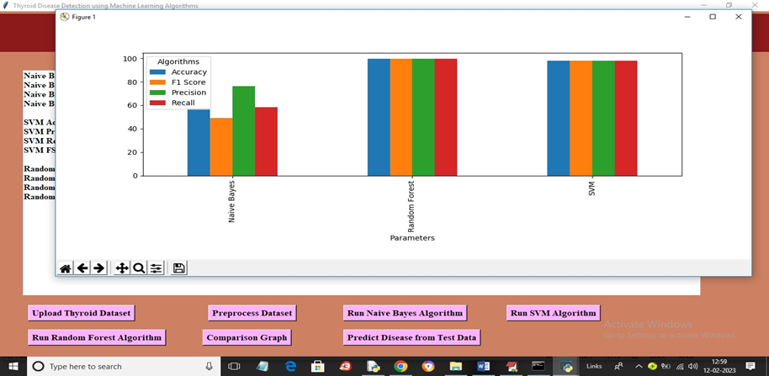

Slide 12
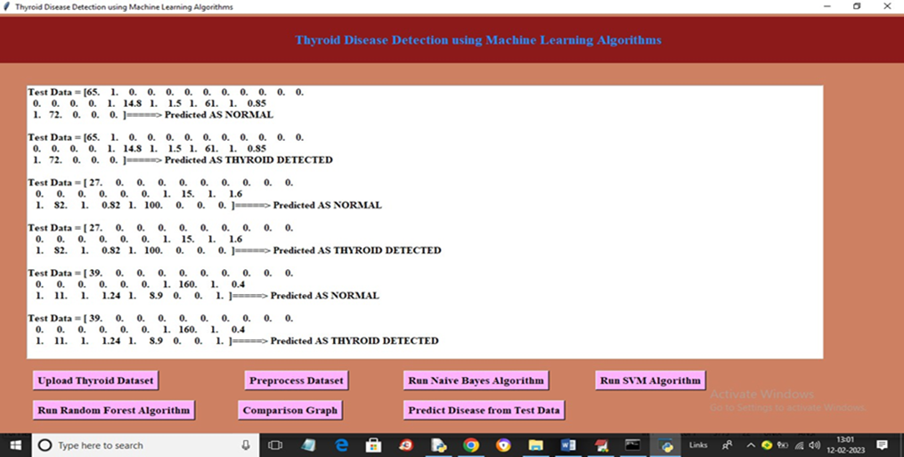

Slide 13
CONCLUSION :
Thus, the proposed work will be very much useful to identify the thyroid disease in a patient at an early stage using classification-based machine learning techniques. These algorithms give various levels of precision and accuracy. These methods also aid in decreasing the unwanted redundant data from the patient’s database. The algorithms used in the proposed model are cost effective and also have good output performance and speed. These classification methods make the treatment of the thyroid patient simple by reducing further complex procedures with an affordable price.

Slide 14
REFERENCE :
https://www.kaggle.com/kumar012/hypothyroid
Bibi Amina Begum and Dr. Parkavi “Prediction of thyroid Disease Using Data Mining Techniques” 5Th International Conference on Advanced Computing & Communication Systems (ICACCS), 2019
Ankith Tyagi, Ritika Mehra, Aditya Saxena “Interactive Thyroid Disease Prediction System Using Machine Learning Technique” 5th IEEE International Conference on Parallel, Distributed and Grid Computing (PDGC-2018), 20-22 Dec, 2018, Solan, India
Aswathi A K and Anil Antony “An Intelligent System for Thyroid Disease Classification and Diagnosis” Proceedings of the 2nd International Conference on Inventive Communication and Computational Technologies (ICICCT 2018) IEEE Xplore Compliant - Part Number: CFP18BAC-ART; ISBN:978-1-5386-1974-2

Slide 15


